Slide 1
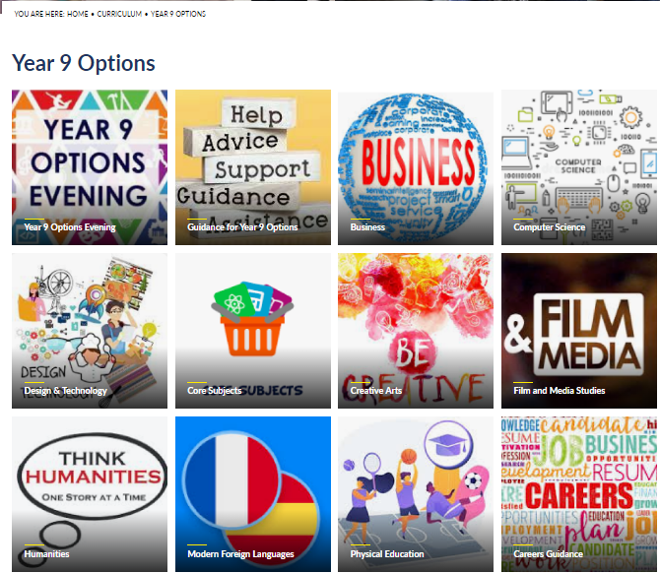

Slide 2




What will my child study?
EVERYBODY studies the ‘common core’:
English Language
English Literature
Mathematics
Science (double or triple)
Core PE – one lesson a week
2 GCSEs
1 GCSE
2 or 3 GCSEs

Slide 3

The option subjects:
French
Spanish
Design and Technology
Food and Nutrition
Textile Technology
Geography
History
Religious Studies
Business Studies
PE
Dance
Drama
Music
Art
Media Studies
Film Studies
Computer Science

Slide 4

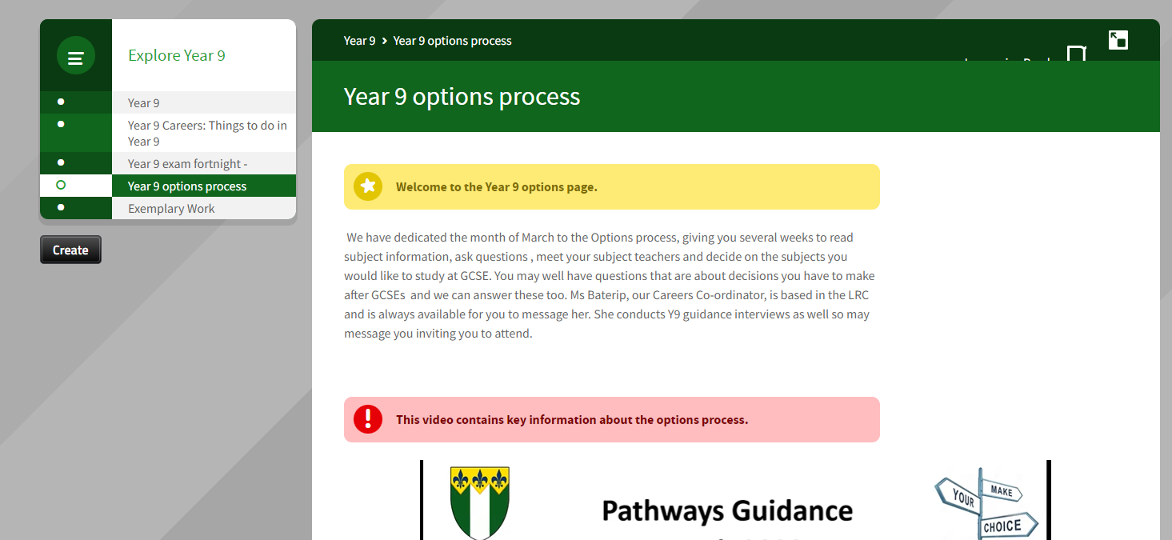
Where can I find information about options?
Students have been set a task on Firefly titled ‘Options information’ with links to both of these!
Firefly
The FBS website

Slide 5

What CAN’T my child choose?
There are certain subject clashes that need to be avoided:
French OR Spanish
Design and Technology OR Textiles Technology
Media Studies OR Film Studies
No more than two of Dance, Music and Drama.
Consider the weighting of coursework and exams!
(Lots of coursework subjects – your child will be busier Jan-April, but will have fewer exams. Are they well organised?)

Slide 6

Can my child take a GCSE in our home language?
Community language GCSEs are available in:
Arabic
Chinese
French
German
Gujarati
Italian
Japanese
Modern Greek
Modern Hebrew
Persian (Farsi)
Polish
Portuguese
Russian
Spanish
Turkish
*these are subject to change!

Slide 7

What is the EBACC?
Also referred to in the options booklet as Pathway A
The core subjects (English Language and Literature; Maths; double or triple Science)
A language – French, Spanish or a Community Language
Either Geography or History (or both!)
Two other options of your choice (or three if doing a community language)
Useful if your child wants to study or work abroad in the future or intends to go to a Russell Group university.

Slide 8

What is Pathway C?
This will only affect a small number of students.
Core subjects are the same.
Three options subjects from the previous list.
Three lessons a week are spent on life skills: for example, developing effective study and revision habits, improving literacy skills and establishing techniques and strategies to assist with further education and the world of work.

Slide 9

Completing the Options form
The options selector will go live on 14th March
Students will be set a task on Firefly explaining how to use it and will be shown a video in form time
Four options choices (three for those on Pathway C) in order of preference and two reserves
Students must have completed the online options form by Friday 21st March.

Slide 10
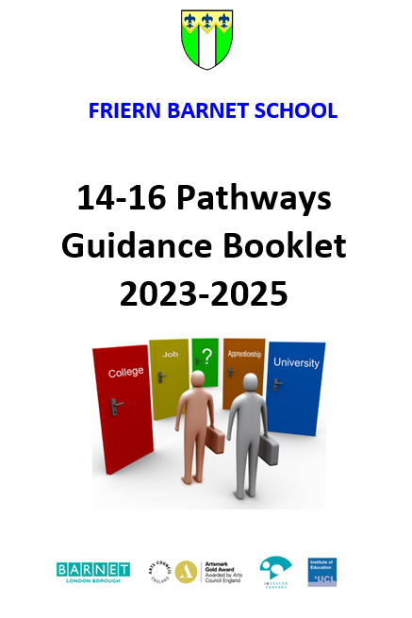
The advice we have given students:
DON’T choose a subject because your friends are doing it
DON’T select an option because it’s taught by your favourite teacher
DO make two reserve choices: we can’t guarantee first choices!
If you would like further advice or have questions:
Ms Newey, Assistant Head Teacher
Ms sacramento, Head of Year 9
Ms Baterip, Head of Careers

Slide 11

FAQ: Is it important that my child knows what career they want to follow?
No, not at this stage. Young people often change their minds - this is a natural process because as they develop as an individual, so do their career intentions. It is important to keep as many doors open as possible and to aim high! However, if they do have a serious career idea they should check if any subjects are essential or desirable. Ms Baterip, the Careers Officer, can offer advice.

Slide 12

FAQ: Can my child change their subject preferences at a later date?
They should consider the option preferences that they make as final. After Easter it will be difficult to change decisions. Students should let us know, as soon as possible, about any changes or concerns they may have about a subject. CHANGES ARE NOT USUALLY ALLOWED AFTER THE START OF JUNE as the timetable will have been put in place by then.

Slide 13


FAQ: What qualifications does my child need to progress to post 16 courses?
Your child will need the equivalent of seven good GCSE qualifications (grade 5 or above) in order to progress to Level 3 (Advanced qualifications, e.g. A levels or BTEC level 3). Students will usually need to attain a grade 6 in their chosen subjects to study them at A level. Some sixth form colleges are requesting students achieve a grade 7 in their chosen subjects in order to start A levels.
Students choosing to follow a more vocational route, such as BTEC, can start a level 2 course with at least 4 grades at a level 3 or above.
Students who do not achieve a grade 4 in English or maths will need to retake these subjects at college.

Slide 14

Planning ahead…
It is important that students reach their potential in Years 10 and 11 so that they can have a range of opportunities available to them at Post 16 for further education, employment or training.
For all types of employment, students will need to demonstrate excellent attendance, a consistently good attitude to learning and good qualifications in English, mathematics and at least five other subjects.

